Slide 1
Metaverse: Lookback & Prospect
404NOTFOUND
221902 李斯宸
221879 张浩然
221877 张品轩
221876 于志鹏
221913 张志伟
221898 肖凌宇
221878 邱宏彬

Slide 2
Big Bang! What Is Metaverse?
Zhang Pinxuan
Professor, School of Computer Science, Southeast University

Slide 3
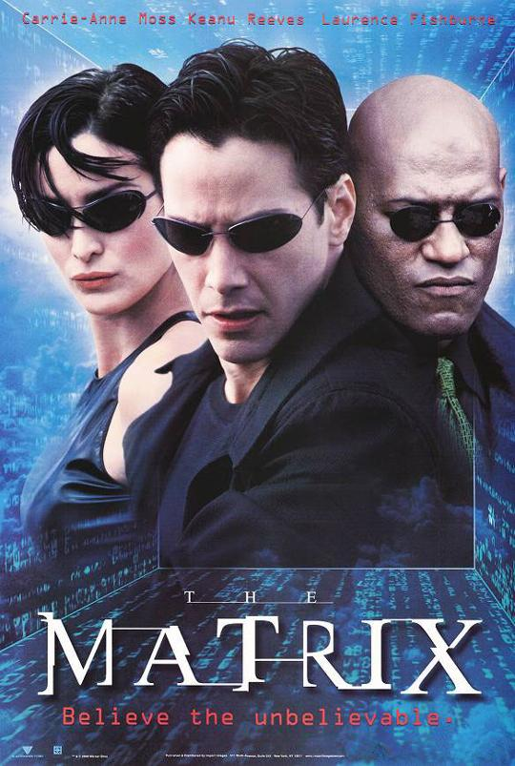

What is Metaverse?
Metaverse: A symbol

Slide 4
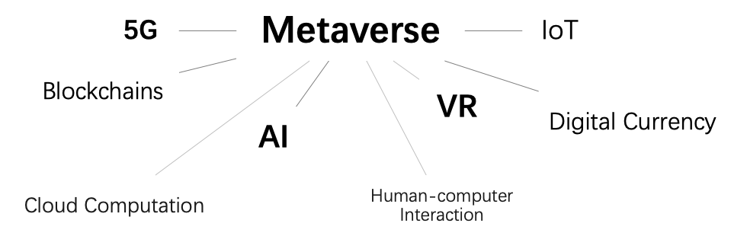
What is Metaverse?
Metaverse: Multi-disciplinary cross-fertilization

Slide 5
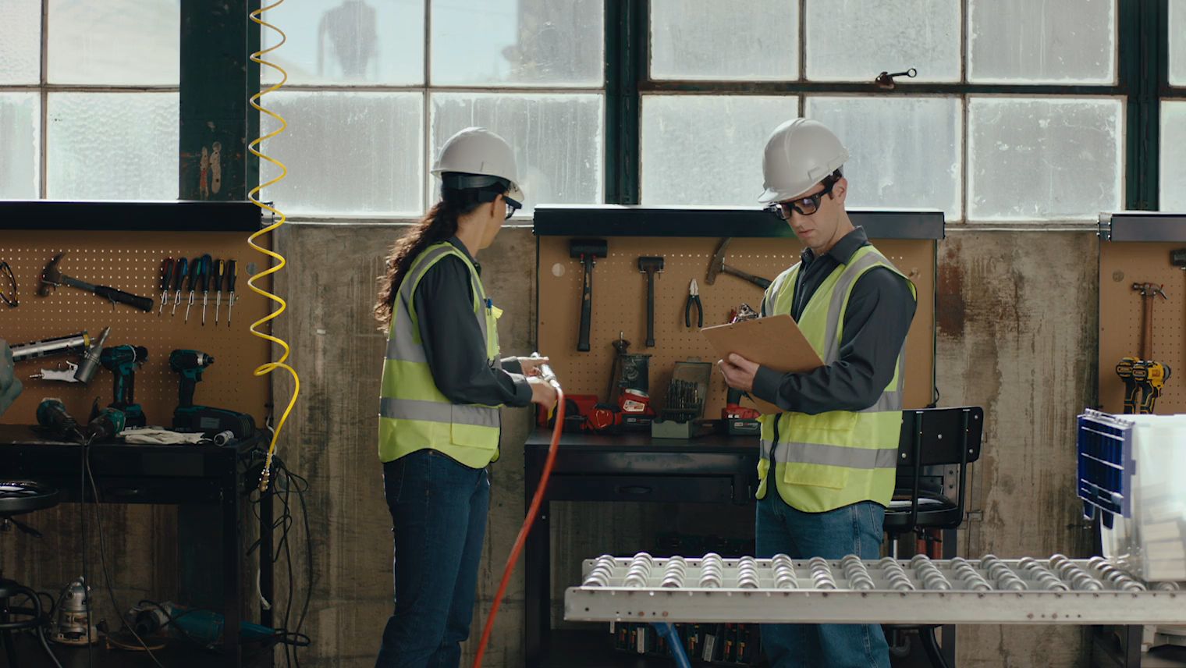
What is Metaverse?
Cores
Interaction
Vision and hearing
Smell, taste and touch
Consciousness

Slide 6
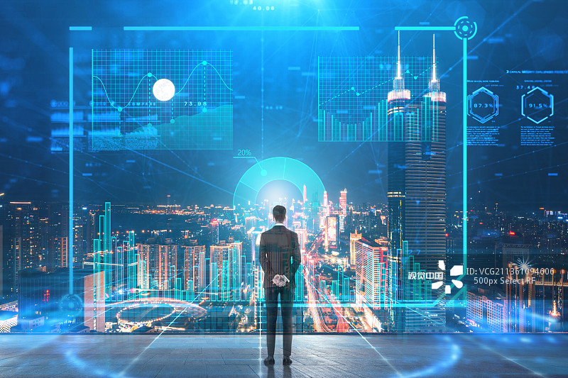
What is Metaverse?
Cores
Connection
Inter-individuals
Human to society
Ultimate goal
A virtual universe

Slide 7
Thank you!
The Big Bang of Metaverse

Slide 8
Reconstruction: Physical to Digital
Yu Zhipeng
Chief Scientist, Department of Wearable Device, Microsoft

Slide 9

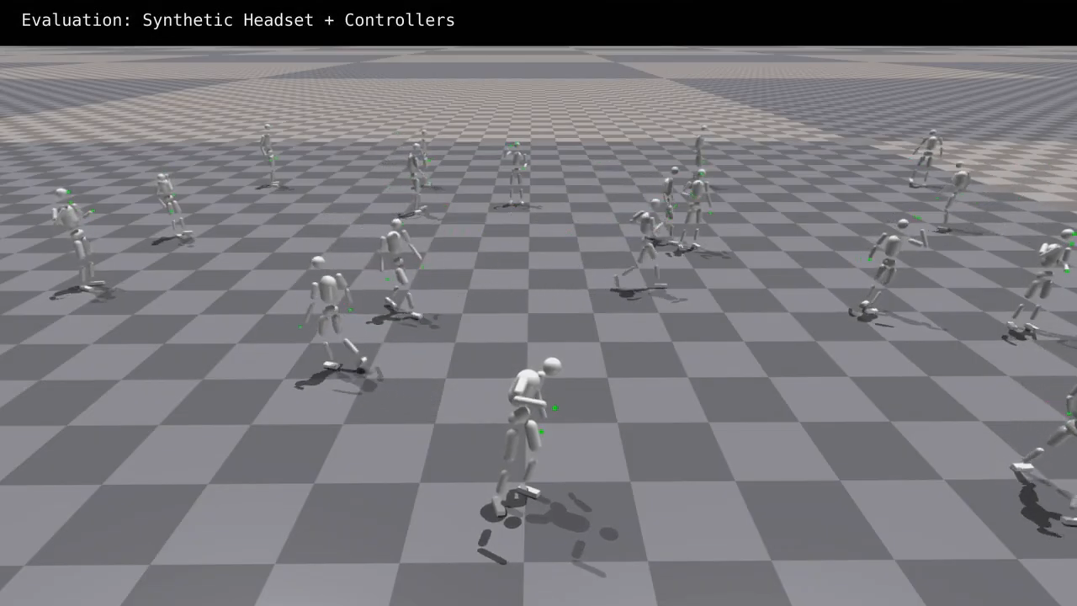
What Reconstruction Techniques Do
Map everything in the real world to the virtual world
Notes:
The fundamental goal of virtual reality reconstruction technology is to map everything in the real world to the virtual world. Imagine how cool it is that you can easily do things that are difficult to do in the real world. You can enjoy countless streams and waterfalls, visit famous relics, or communicate with people thousands of miles away in a virtual space just at home.

Slide 10
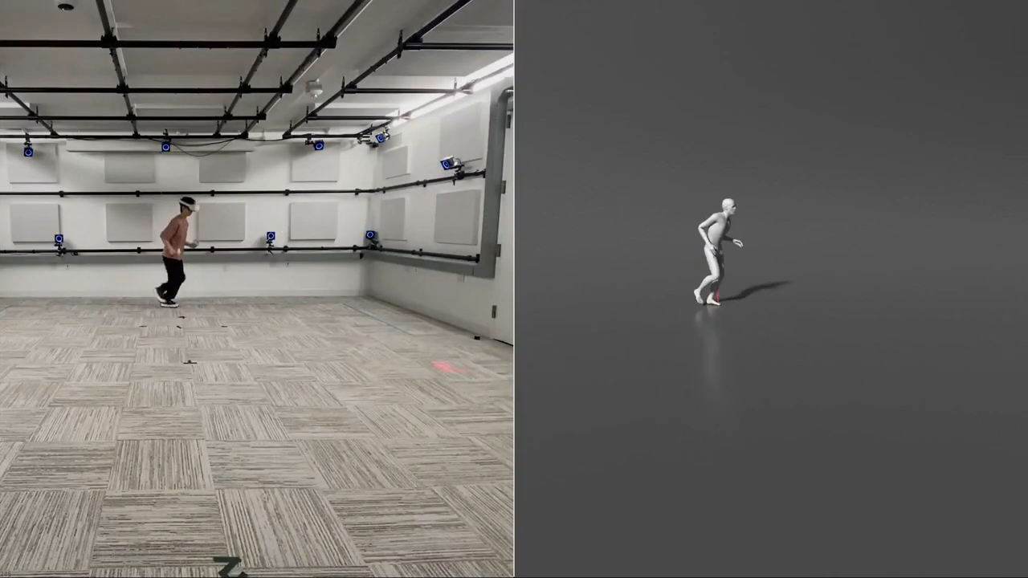
Recent Reconstruction Techniques
Scene Reconstruction
Person Reconstruction
Notes:
Today, reconstruction technology has been developed to a certain extent. We can reconstruct the scene just using the camera in your cell phone. Also we can reconstruct a fairly realistic three-dimensional avatar for specific persons just using one of their pictures. whats more, we can use the physics engine to simulate what will happen in real life.

Slide 11
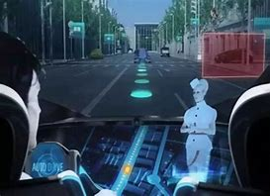
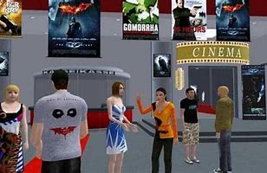
Future of Reconstruction Techniques
Notes:
In the future, the reconstruction from the physical world to the digital world will be faster, finer, and more accurate. I believe that the digital world will eventually become our second world, and all of us will be able to enjoy the fun of wandering in the digital ocean.

Slide 12
Summary
Goals
Present Situation
Future
Notes:
The themes I have dealt with can be boiled down as the goals, present situation, and future of virtual reality reconstruction technical. That's all for my talk. Thanks for your attention!

Slide 13
Thank you!
Bringing Virtuality to Reality

Slide 14
The Real Value of Virtual Estates
Zhang Zhiwei
Executive Editor, The Economist

Slide 15
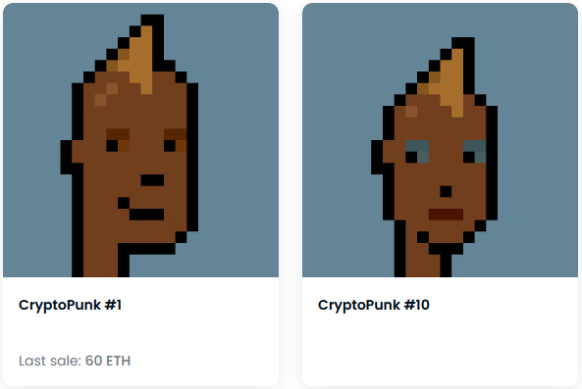
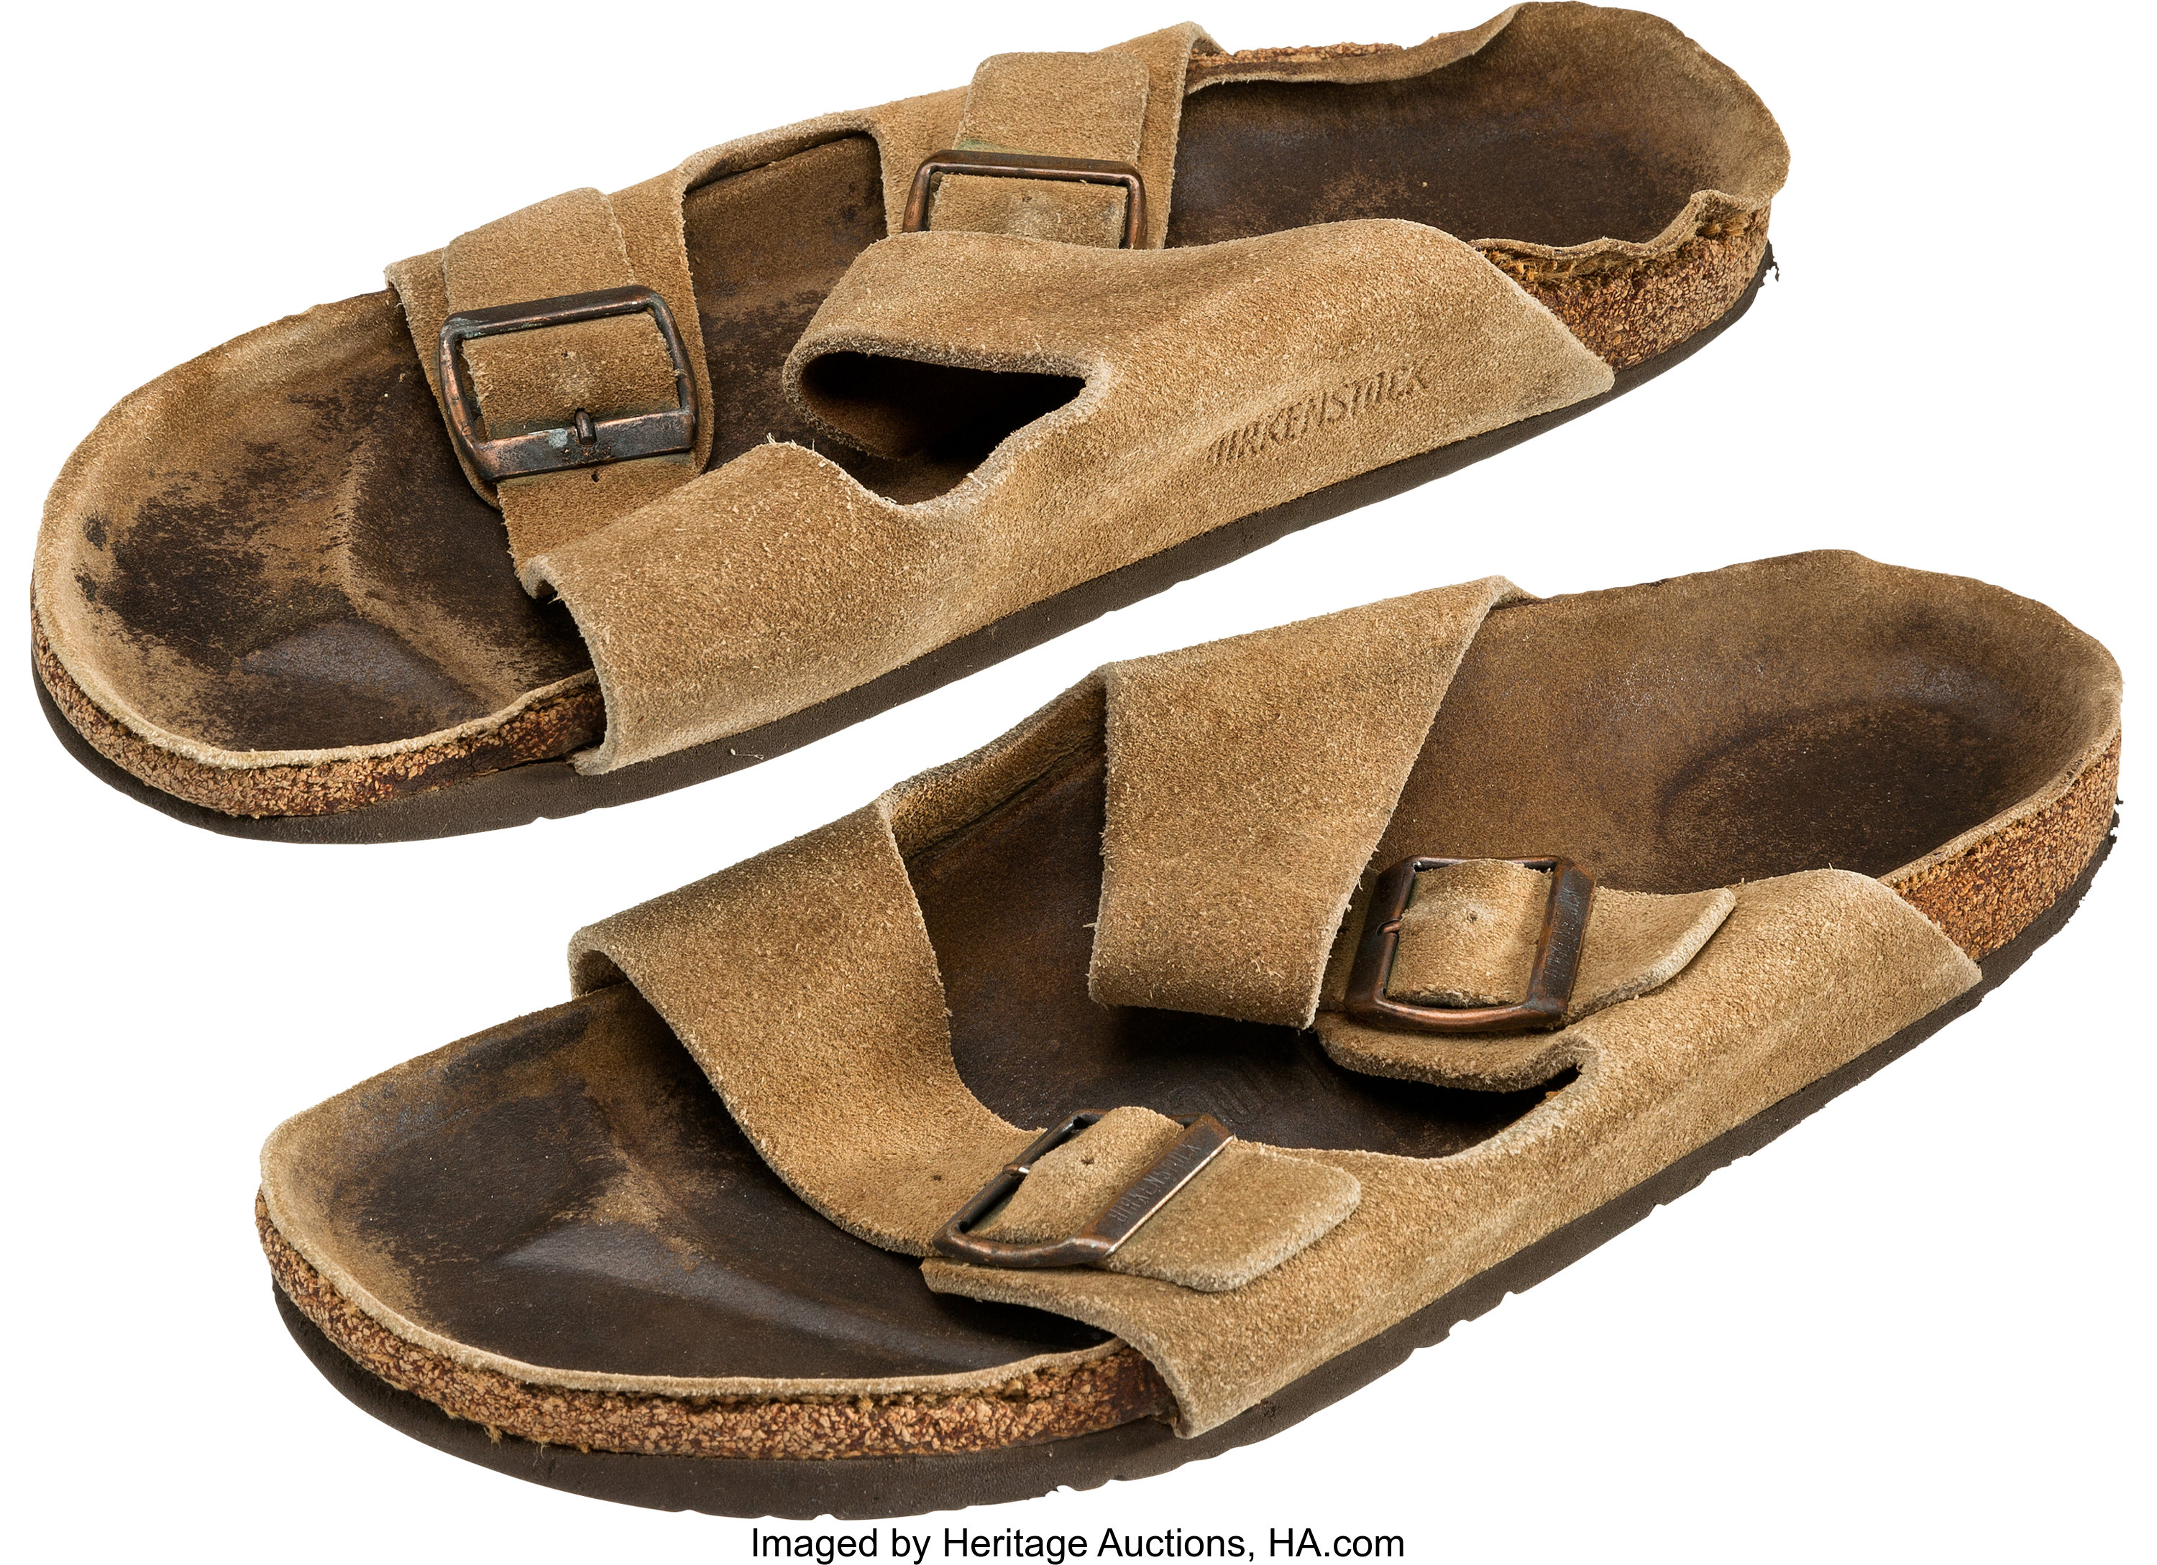
Value of Virtual Assets
OpenSea, the largest NFT marketplace
Total volume: $500M
Volume of the Most popular collection: 1M ETH
NFT of Steve Jobs’ worn-out sandals
Sold out at $218,750, Nov. 16th, 2022

Slide 16
Origin of Value: Start from Reality
Painting of an artist
Piece of gold
CPU chip

Slide 17
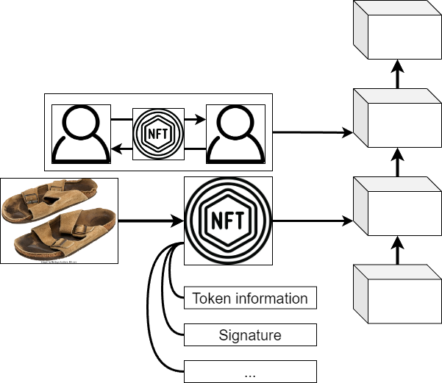
Uniqueness: Basic Concept of NFT
Non-Fungible Token: Certificate of ownership
One and only across the blockchain
Secure signature
Forged from anything
Contractable

Slide 18
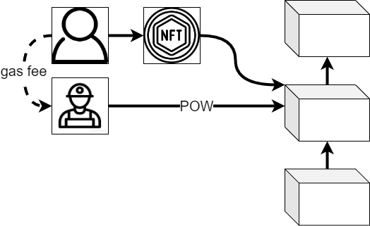
Scarcity: Slow growth of Blockchain
NFT as an attachment of blockchain
Generation
Exchanges
...
New blocks in blockchain require proof
POW: Proof of Work – Mining of encrypted currency
Time and energy consumption of POW – Gas fee

Slide 19
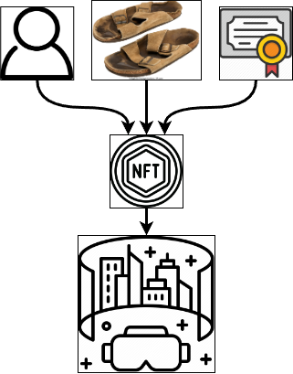
Utility: NFT in Metaverse
Special personal avatars
Identity
Detailed customization
Mapping from reality to cloud
Copy anything to Metaverse using NFT
Decentralized ownership certificate
Financial bills
Title deeds
...

Slide 20
The Real Value of Virtual Estates
Uniqueness
Non-fungible and secure ownership token
Scarcity
Limited supply
Concentration of work across the web
Utility
Import anything into Metaverse
Tool of certification

Slide 21
Thank you!
Virtual Assets Worth Real Gold

Slide 22
Q&A Session
Xiao Lingyu
Expert of Research Group, Google Inc.

Slide 23
Metaverse: Lookback & Prospect
404NOTFOUND
221902 李斯宸
221879 张浩然
221877 张品轩
221876 于志鹏
221913 张志伟
221898 肖凌宇
221878 邱宏彬

